Slide 1
Advanced English
9th November

Slide 2
I hope to ______________________________.
I want to ______________________________.
I need to ______________________________.
I promise to ___________________________.
I plan to ______________________________.
I decided to ___________________________.
I would like to _________________________.

Slide 3
Gerunds

Slide 4
What is a gerund?
A gerund is a verb ending in -ing that acts as a noun.
We use gerunds after certain verbs, such as enjoy, finish, avoid, and mind.
Structure:
Subject + Verb + Verb-ing
Examples:
I enjoy swimming.
She finished eating.
He avoids running.
They keep talking.
Important: Some verbs are followed by gerunds, while others are followed by infinitives.
I enjoy playing football. ✓
I enjoy to play football. ✗
I want to play football. ✓
I want playing football. ✗

Slide 5
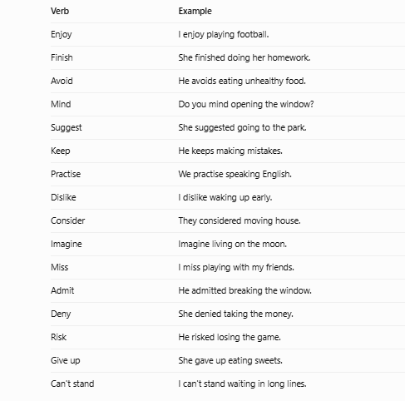
Verbs followed by gerunds

Slide 6
Gerunds as subjects
We can also use a gerund at the beginning of a sentence.
Examples:
Swimming is good exercise.
Reading helps you learn English.
Eating vegetables is healthy.
Playing games is fun.

Slide 7
Writing activity
Complete the sentences with your own ideas.
I enjoy __________________________________.
I dislike _________________________________.
I avoid __________________________________.
I keep ___________________________________.
I practise ________________________________.

Slide 8
Complete the sentences with a gerund.
I enjoy __________ movies.
She finished __________ her homework.
He avoids __________ junk food.
They keep __________ in class.
We practise __________ English.
Do you mind __________ me?
She suggested __________swimming.
I dislike __________ up early.
He admitted __________the glass.
They considered __________ a new car.

